Slide 1

Synthesis & characterisation of β-Diketonate complex of Lanthanides and their Luminescence
Presentation on
BY
Vijay Kumar
Under the guidance of
Dr. Rahisuddin
Associate professor
Department of Chemistry
Jamia Millia Islamia (A Central University)
New- Delhi-110025

Slide 2
Introduction
Lanthanides complexes of β-diketonate have a wide range of sensor applications.
Lanthanides complexes of β-diketonate serve as a energy-efficient emissive materials like OLED and lasers.
β-Diketonate complex of Lanthanides have many applications in catalytic reactions viz. oxidation of o-hydroxy phenol into o-quinone and Catalytic reduction of carboxamides into their corresponding amines etc.

Slide 3
Applications of Lanthanides complexes of β-diketonate
Lasers
Display devices
Protein labeling
OLED
Biological assay
Biological imaging applications

Slide 4
METHODOLOGY
1. Synthesis of chelates (1-3)
1 mmol of LnCl₃.6H₂O is dissolved in adequate-water. In the minimum amount of ethanol, 3 mmol TTA and the same mmoles of 1N NaOH were added slowly. After mixing the solution, 200 ml of distilled water is added, and the reaction is held at 60ºC for 5-10 minutes. Further, the mixture was on constant stirring at room temperature for 5-6 hours. After the completion of the reaction, the precipitate is filtered off and evacuated in a desiccator (scheme 1).

Slide 5
Scheme 1. Synthesis of chelates (1-3)

Slide 6
2.Synthesis of metal complexes(4-6)
Ln(TTA)₃H2O is dissolved in minimum amount of ethanol. Same mole of ancillary-ligand (6-Aminoindazole) is dissolved in minimum amount of ethanol. Both the mixtures are added slowly by stirring. Finally, the mixture is stirred for 3-4 hours. The product obtained is recovered by washing in hexane (scheme 2).

Slide 7
Scheme 2. Synthesis of metal complexes (4-6)

Slide 8
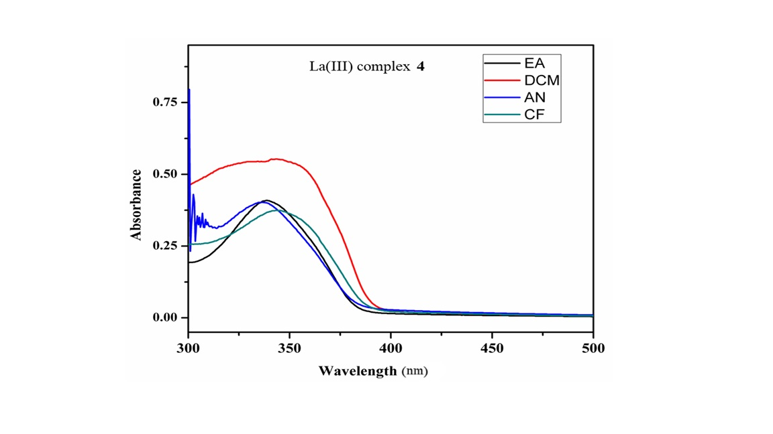
Electronic spectra of complexes (4-6)
The UV absorption spectra of all the complexes were measured in four different solvents, viz, AN, EA, CF and DCM. The absorption spectra of all the three complexes (Complex 4-6) appears in the range of 300- 400 (Figure 5). These bands are assigned to π → π* (S₀ → S₁₎ transition. These strong absorptions in this range divulges that the ligands have successfully coordinated with the metal ions.

Slide 9
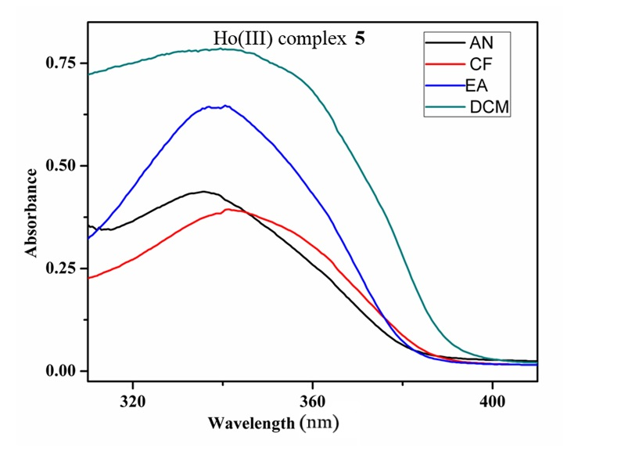
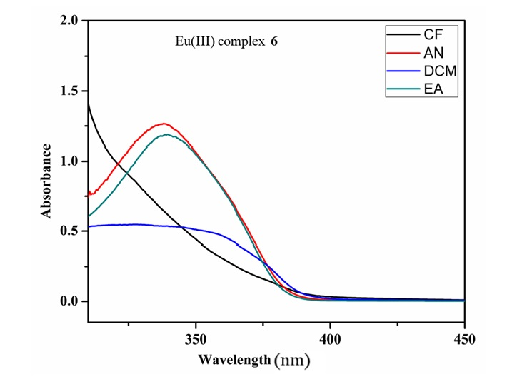

Slide 10
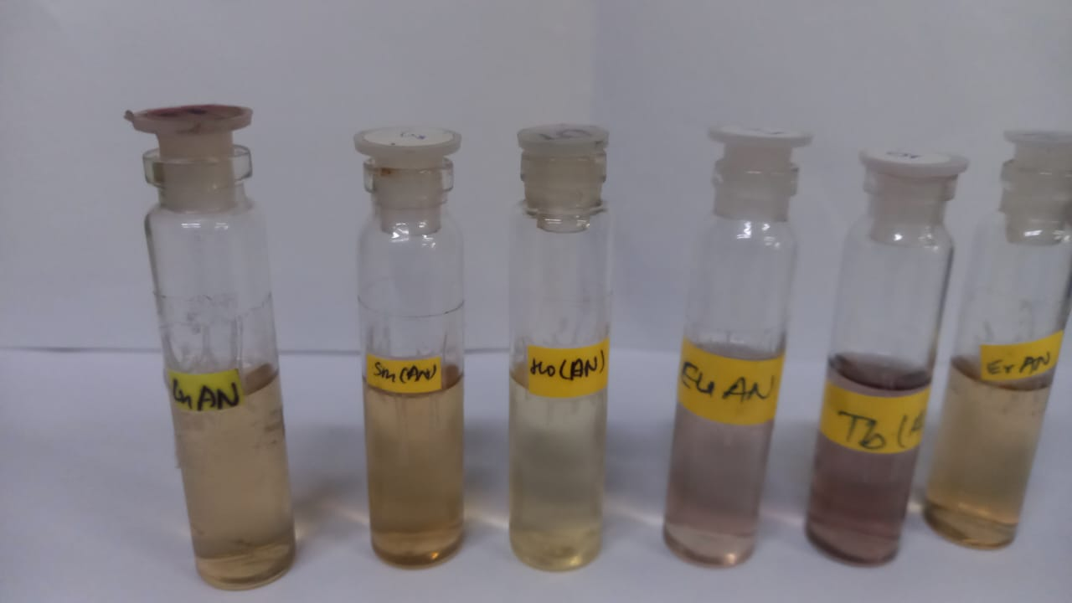
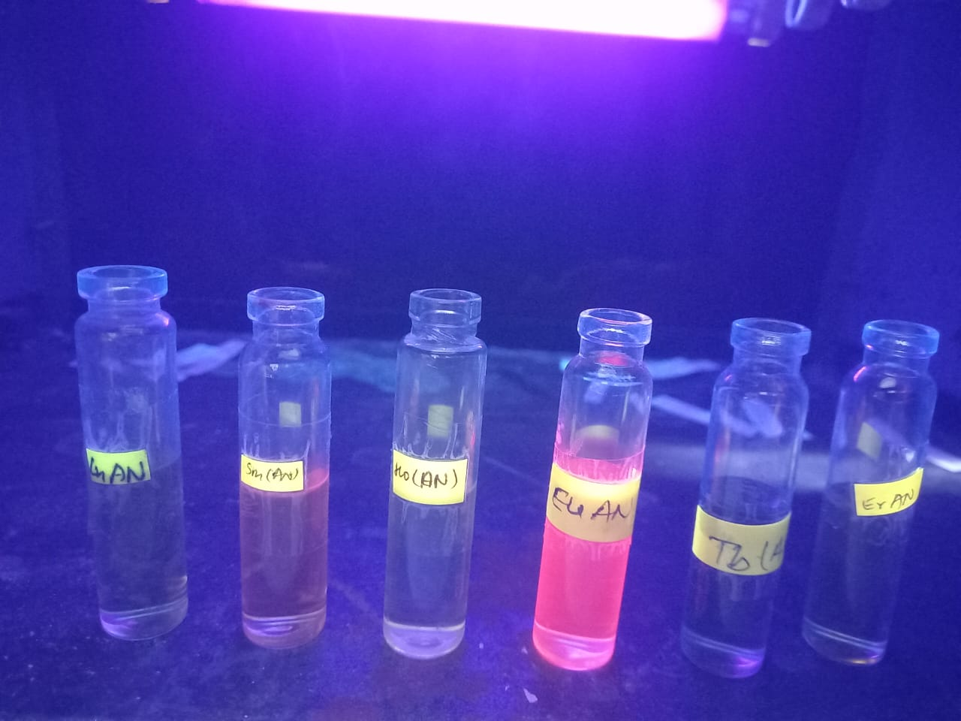
Fluorescence

Slide 11
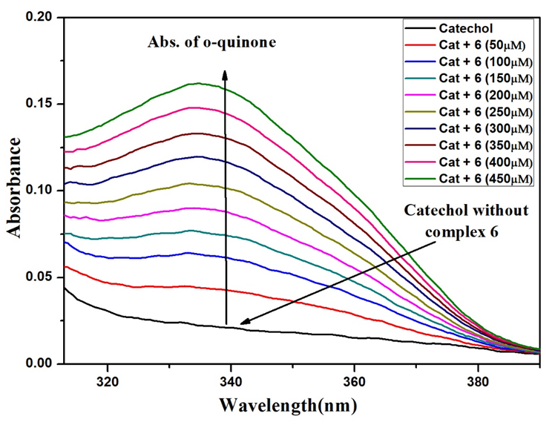
Catechol activity
Figure 8. Catechol UV spectra of Eu(III) complex (6)

Slide 12
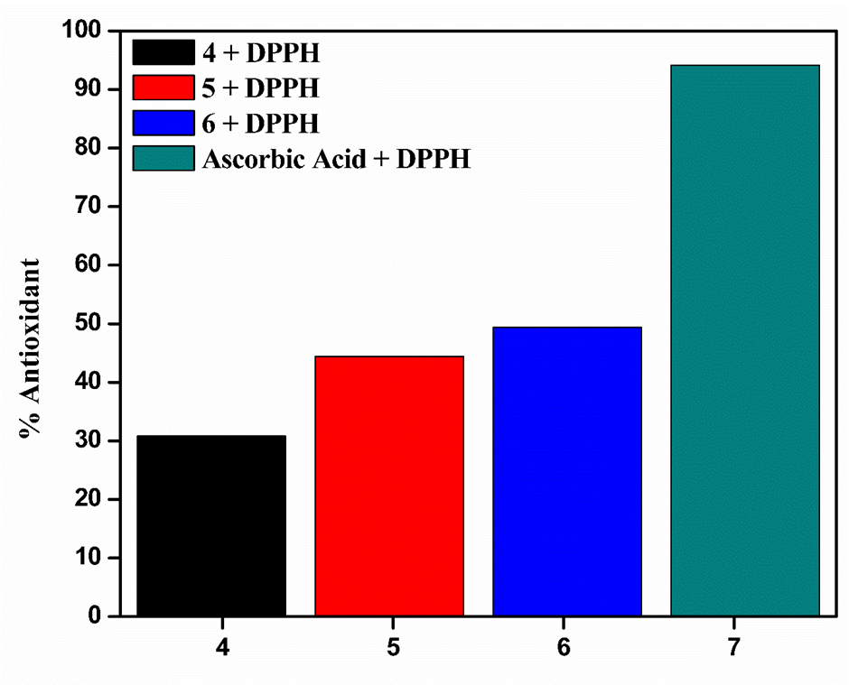
Antioxidant activity
DPPH free radical scavenging assay
The percentage antioxidant activity were found for the complexes 4,5 and 6 as 31, 44 and 51 respectively.
Figure 9. Antioxidant activity of complexes (4-6) in DPPH

Slide 13
Molar conductance measurement
Complex code | Complexes | Molar conductance (Scm²mol⁻¹)
4 | [La(TTA)₃Im] | 41
5 | [Ho(TTA)₃Im] | 38
6 | [Eu(TTA)₃Im] | 37

Slide 14
Further study
Characterization techniques : FTIR , 1HNMR, 13 CNMR

Slide 15
THANK YOU!

